Slide 1

Are You Hungry
You Got Hunger Box

Slide 2
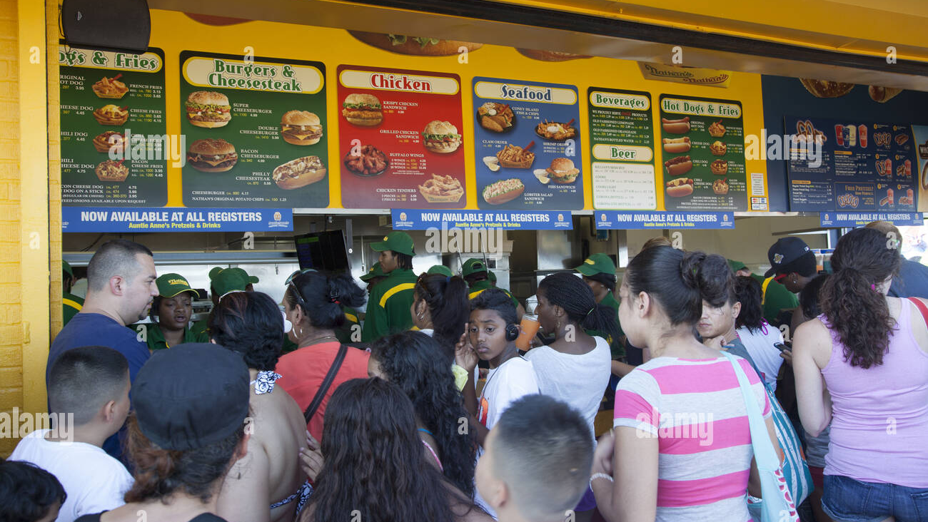

Slide 3
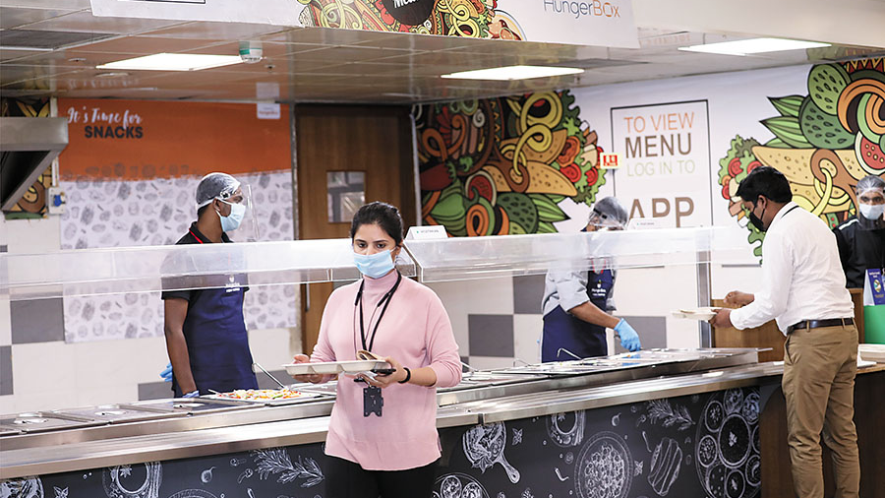

Slide 4
What is Hungerbox
Food-Tech company
Hassle-free Cafeteria Experience
For Educational institutes and Food Courts at Tech Parks, Malls & Multiplexes, Corporate Offices.

Slide 5
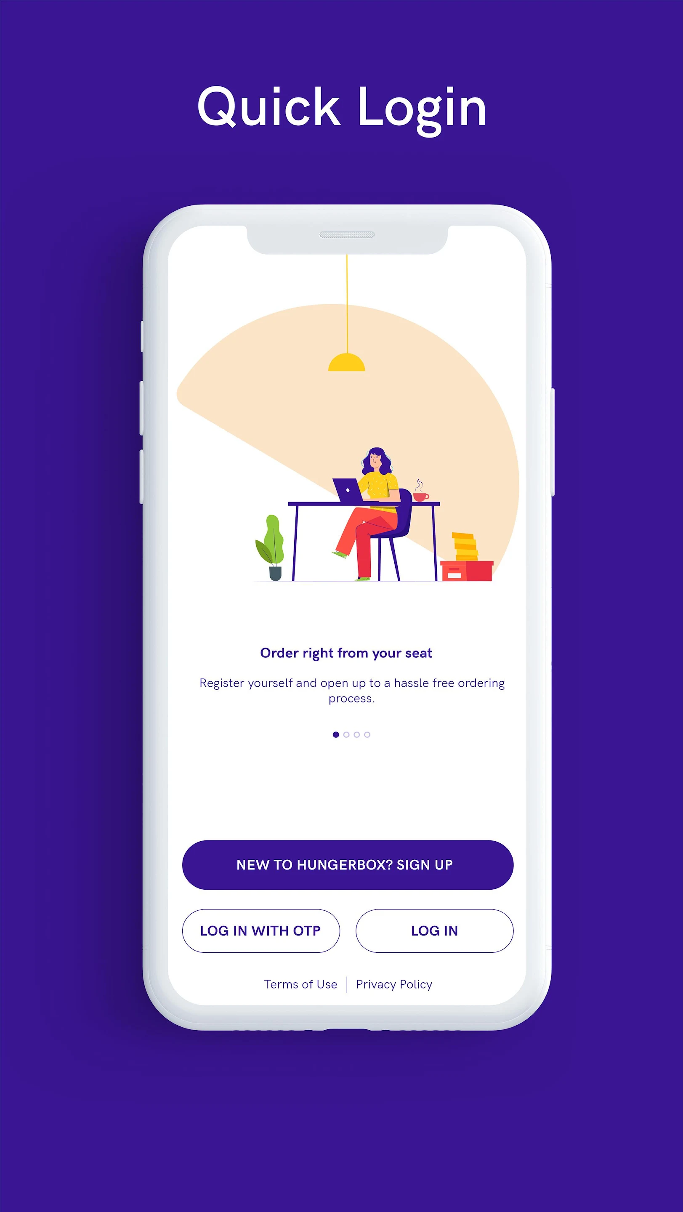
Quick Login
Using Google Account
Using Mobile Number

Slide 6
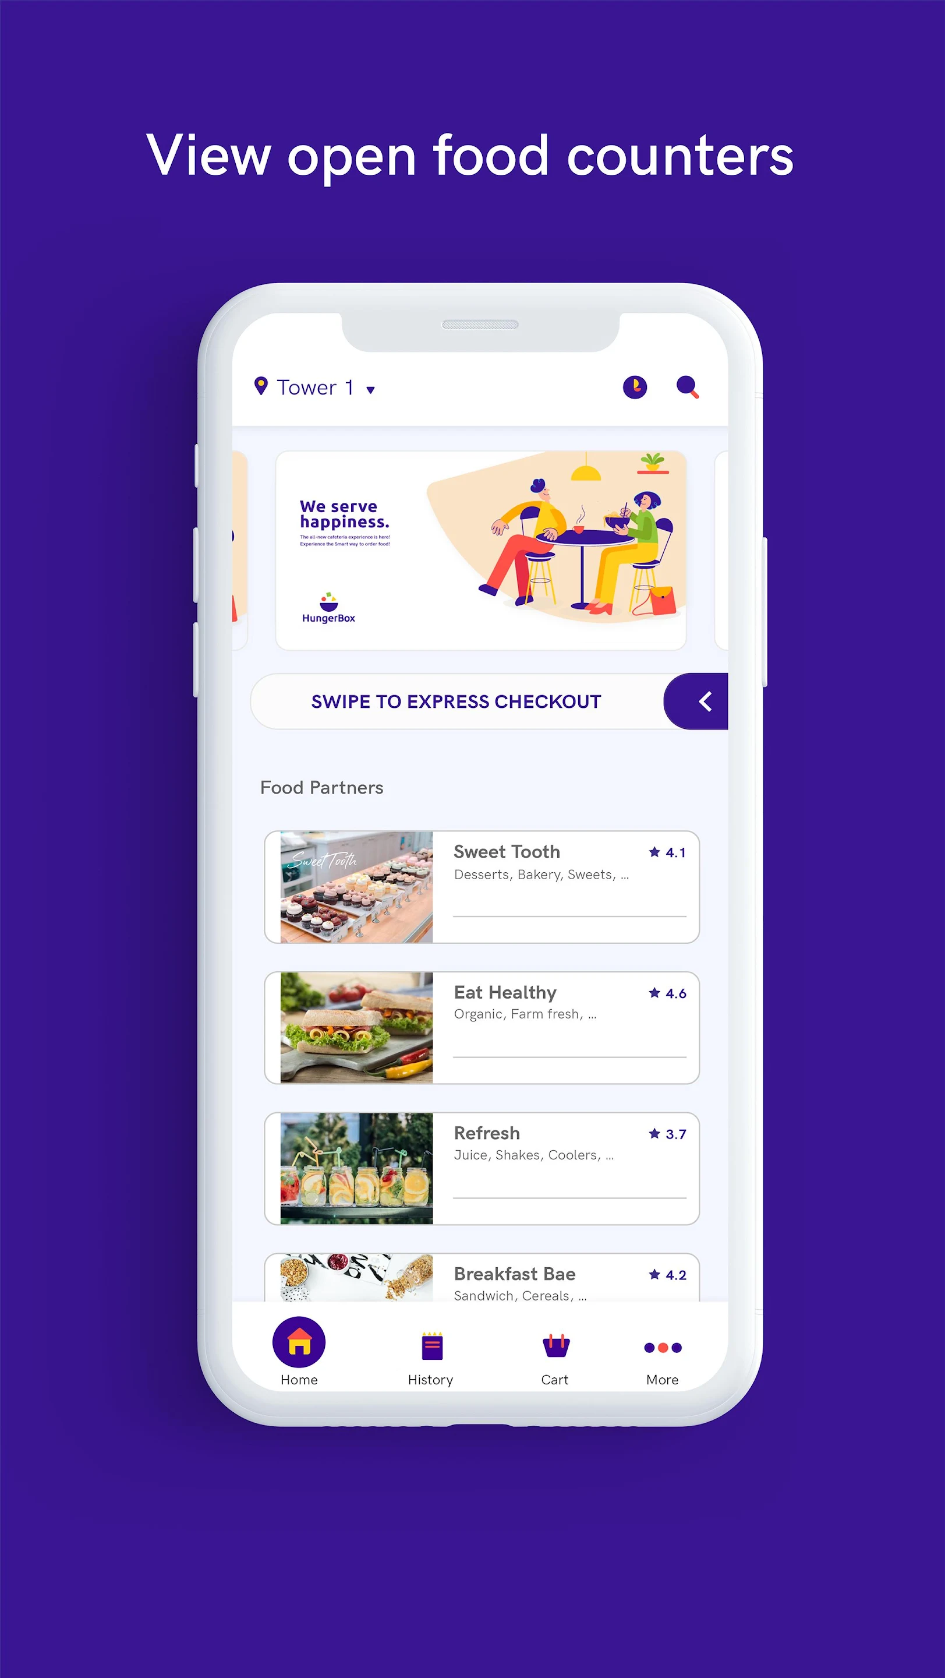
Find Out Food Counters

Slide 7
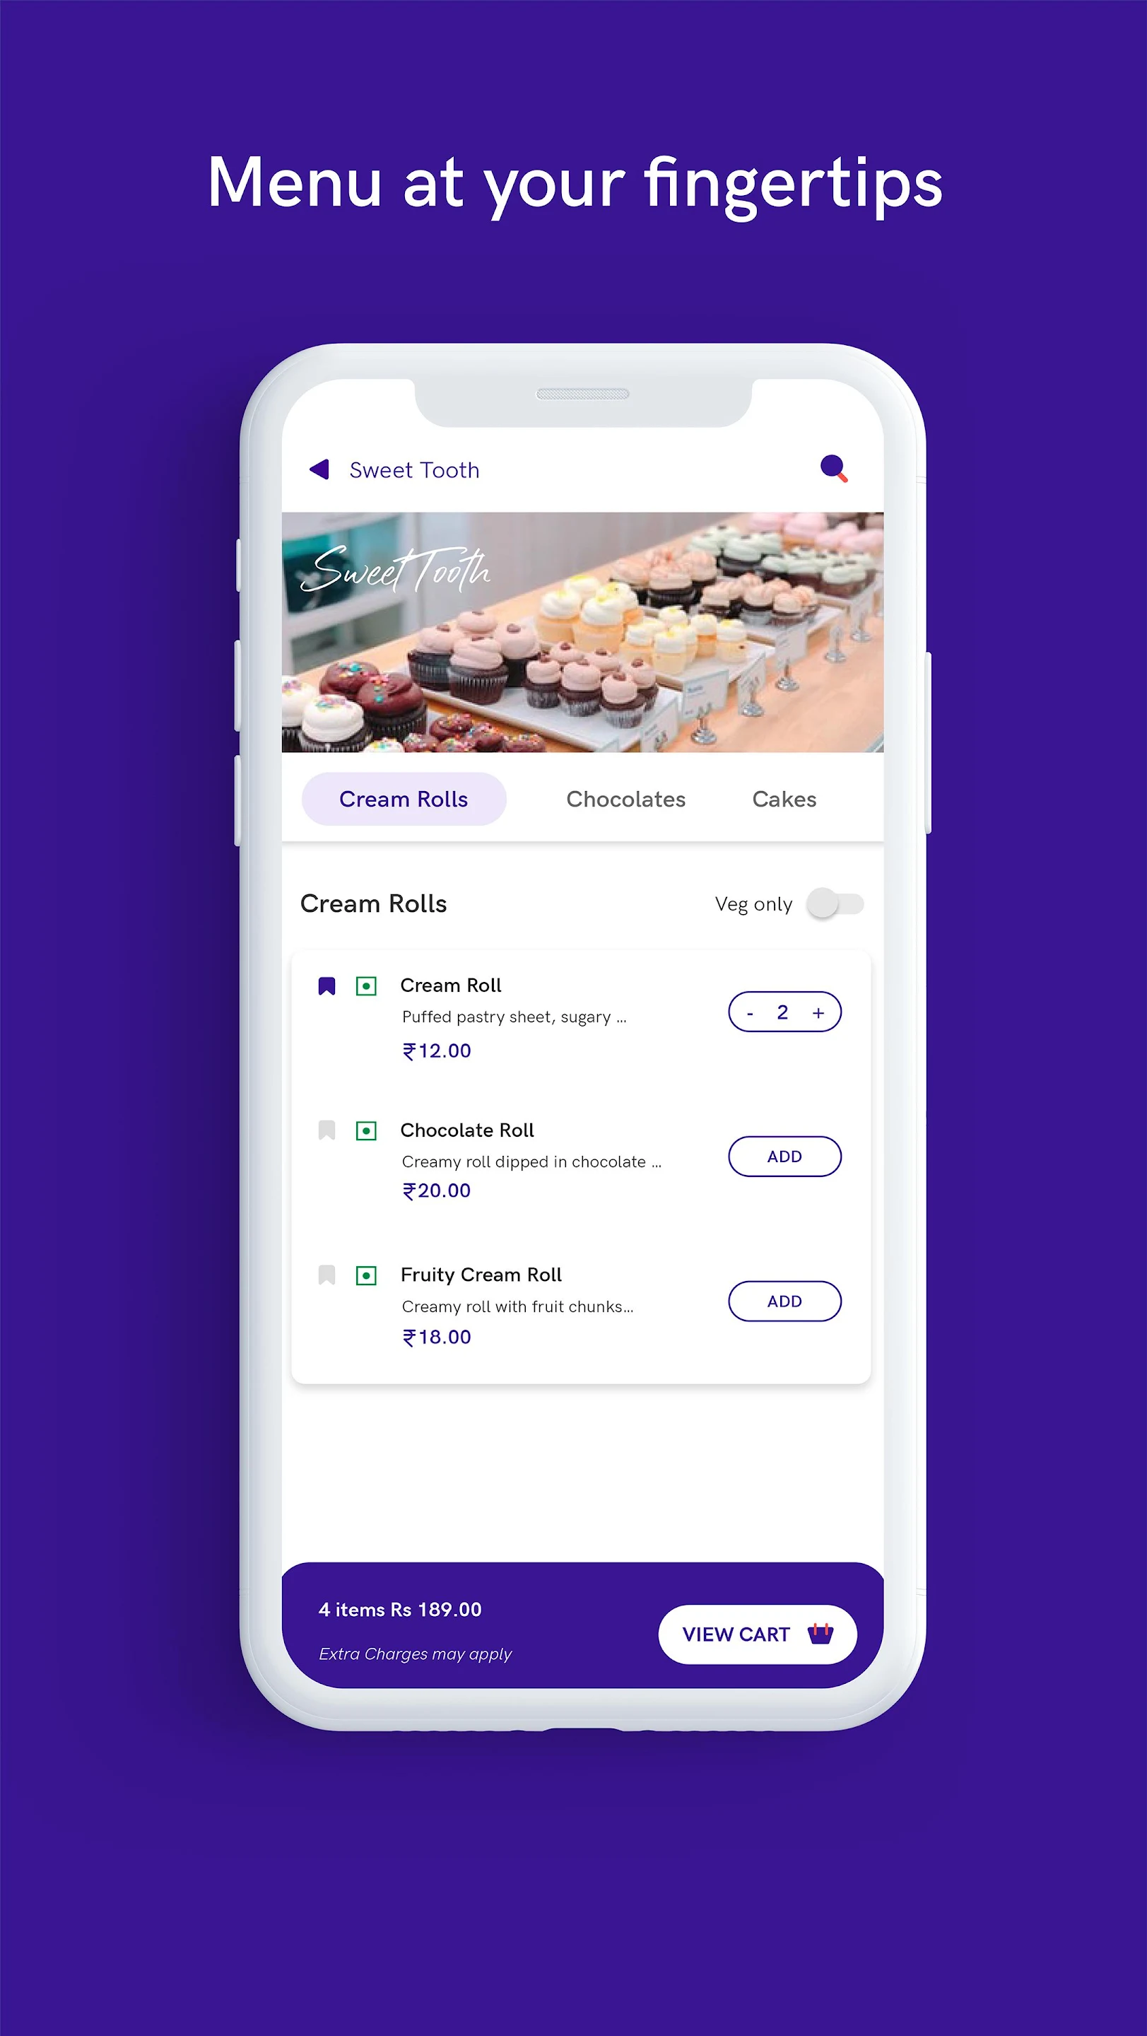
Add Your Favorite Items to Cart

Slide 8
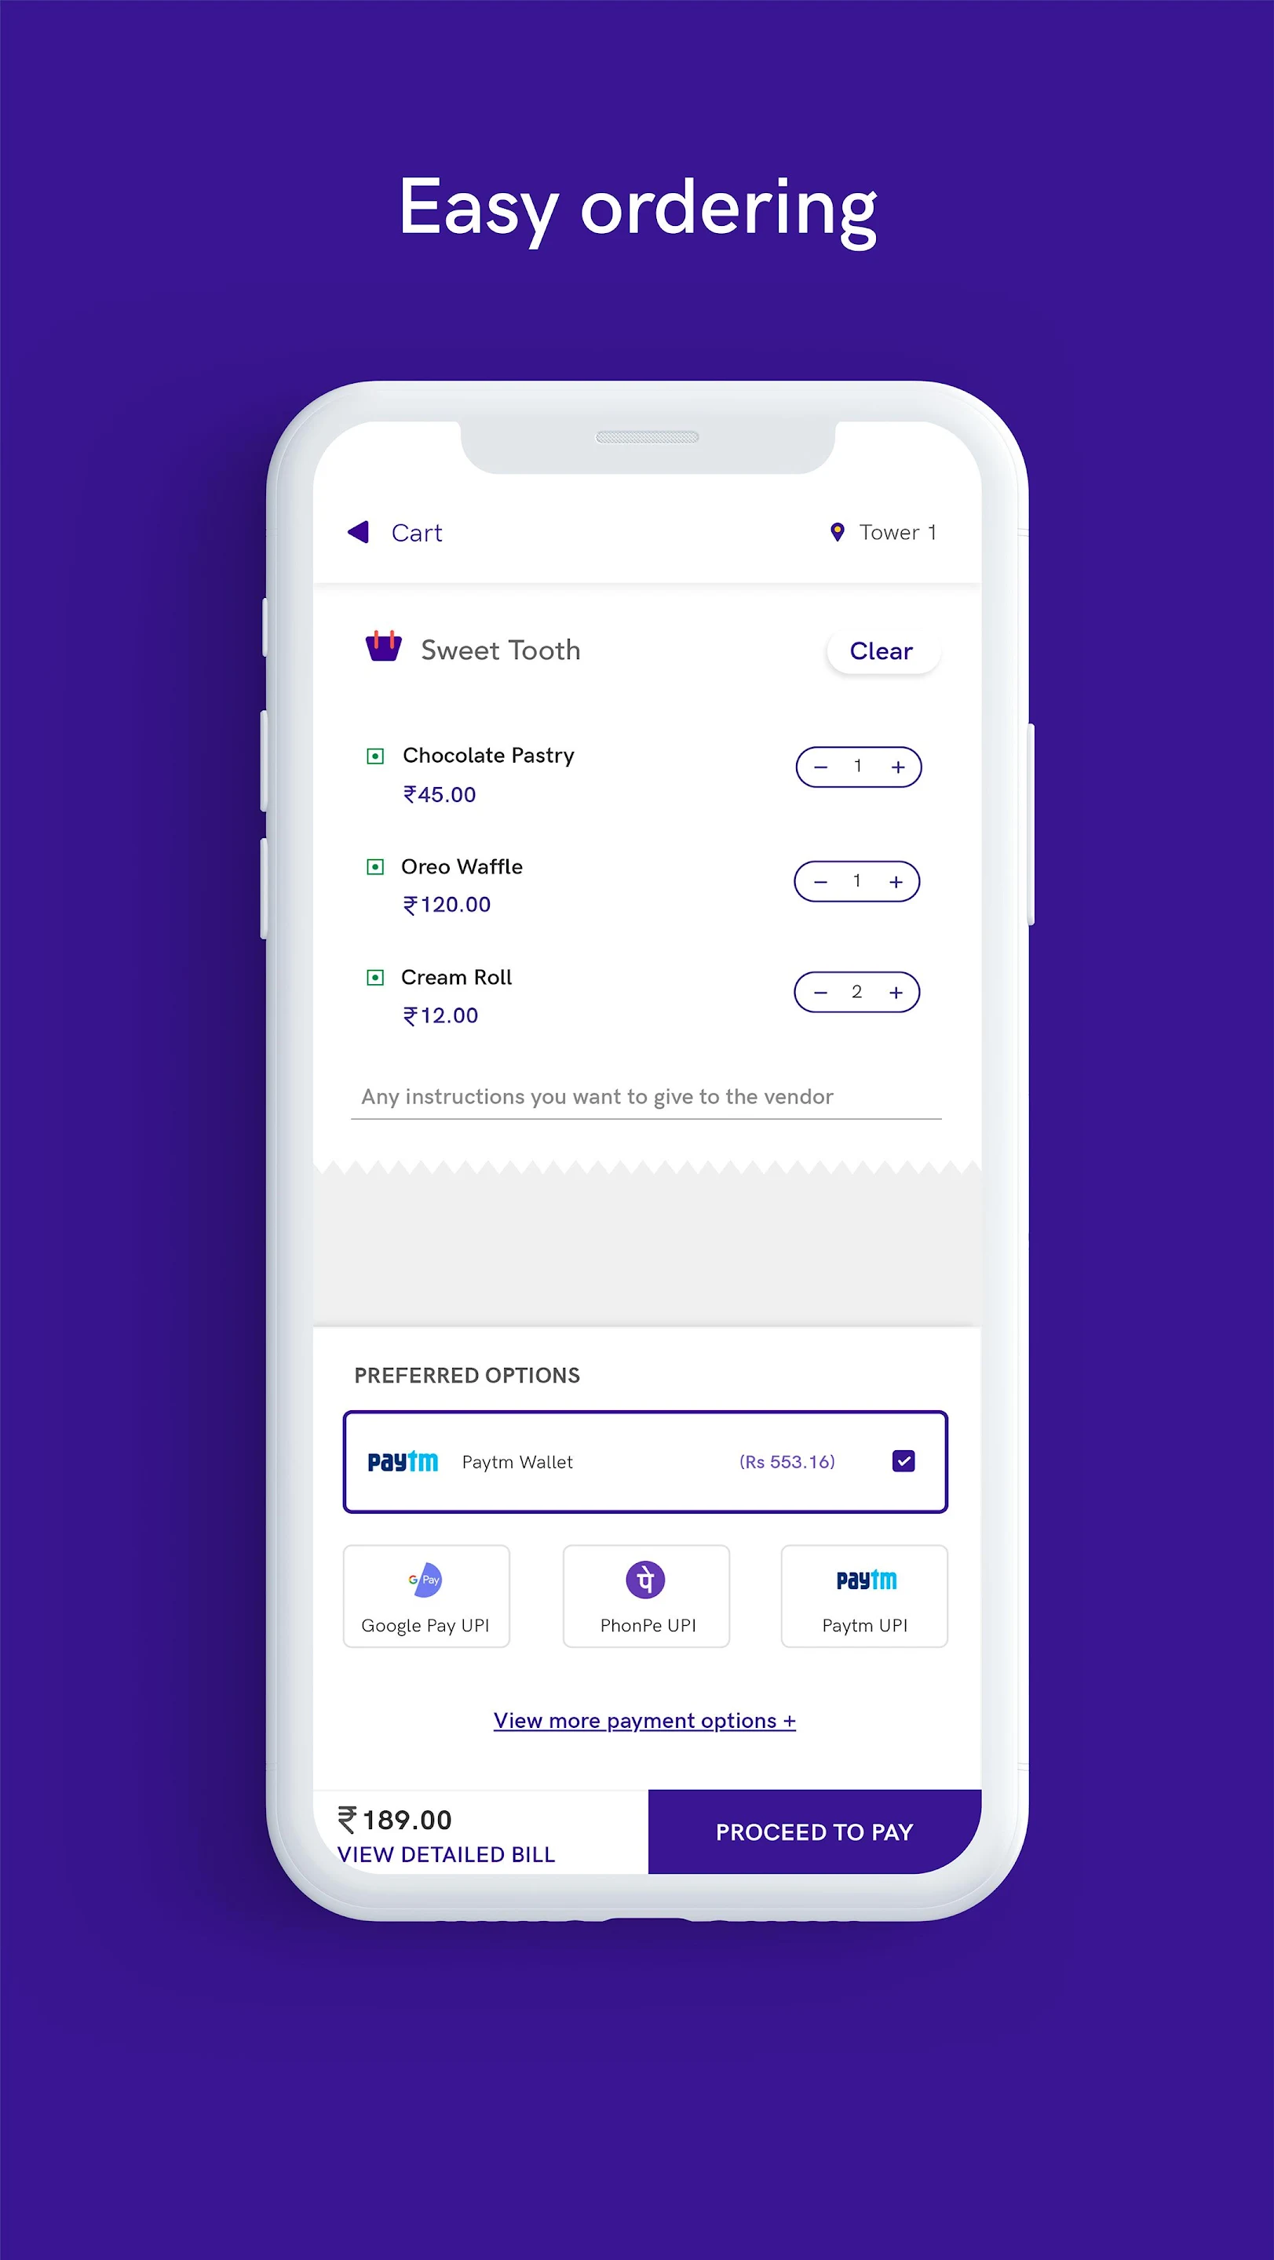
Pay Using Favorite Mode of Payment
Google Pay
Phone Pay
Paytm
Card

Slide 9
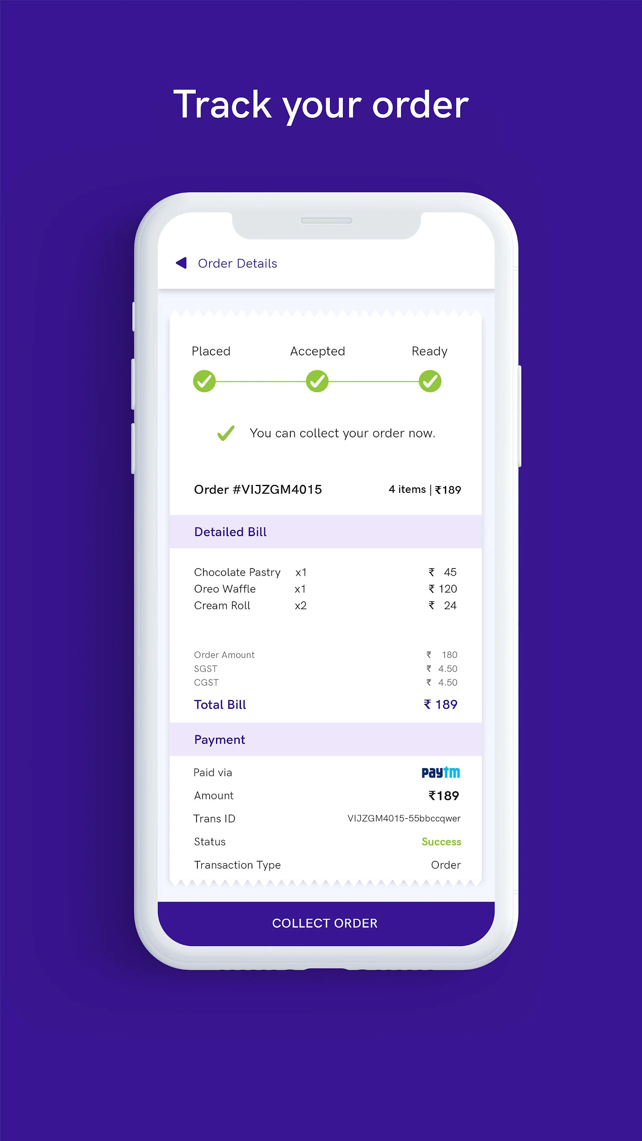
Track Your Order
Using Google Account
Using Mobile Number

Slide 10

Enjoy Your Meal

